Slide 1
Hackathon by Prudent Globaltech Solutions Project on: Sentiment analysis model to analyze customer reviews and feedback for a hospitable company.
By:
Nandamuri Paul Gabriel Richman
Email: jcts9725@gmail.com
Ph no: +918349150722

Slide 2
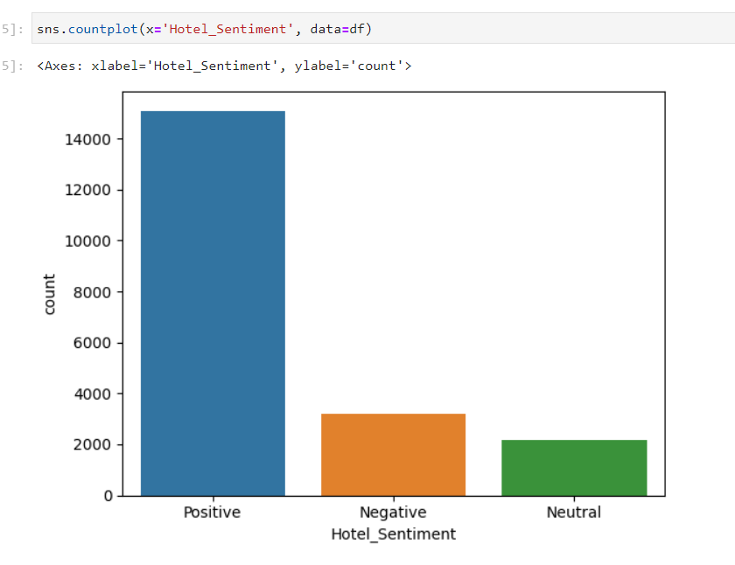
Developing the Sentiment Analysis Model
- Identify Input and Output Variables: Define input (customer reviews) and output (positive/negative sentiment).
- Split Data into Training and Testing Sets: Divide dataset for training and testing model performance.
- Preprocess Training Data: Clean and preprocess training data to remove noise and irrelevant information.
- Preprocess Testing Data: Apply same preprocessing to testing data for consistency.
- Build a Model (e.g., Naïve Bayes): Construct sentiment analysis model using chosen algorithm.
- Evaluate Model Performance on Training Data: Assess model fit to training data.
- Evaluate Model Performance on Testing Data: Test model on unseen data for accuracy and generalization.

Slide 3
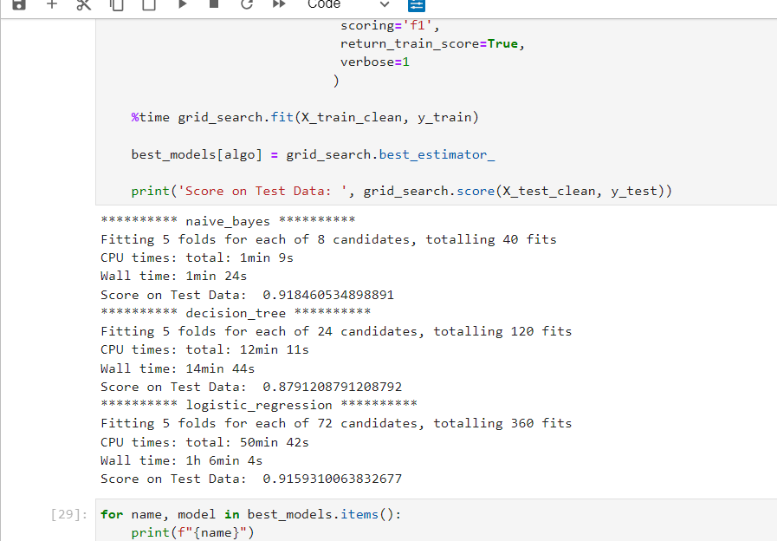
Model Selection and Deployment
- Model Comparison: Compare Naïve Bayes, Decision Tree, and Logistic Regression.
- Build a Pipeline for Model Comparison: Create a pipeline for comparing multiple models.
- Select the best-performing model: Choose the model with the highest accuracy and performance metrics.
- Store the Best Model: Save selected model for future use and deployment.
- Deploy the Model using Flask: Utilize Flask to deploy the sentiment analysis model as a web application.
Deployment on AWS (In Progress): Work towards deploying applications on Amazon Web Services for accessibility and scalability.
Through the pipeline Naïve Bayes model had the best test –score, So we’ll be using this model in the flask application.

